Slide 1
Gingival enlargement

Slide 2
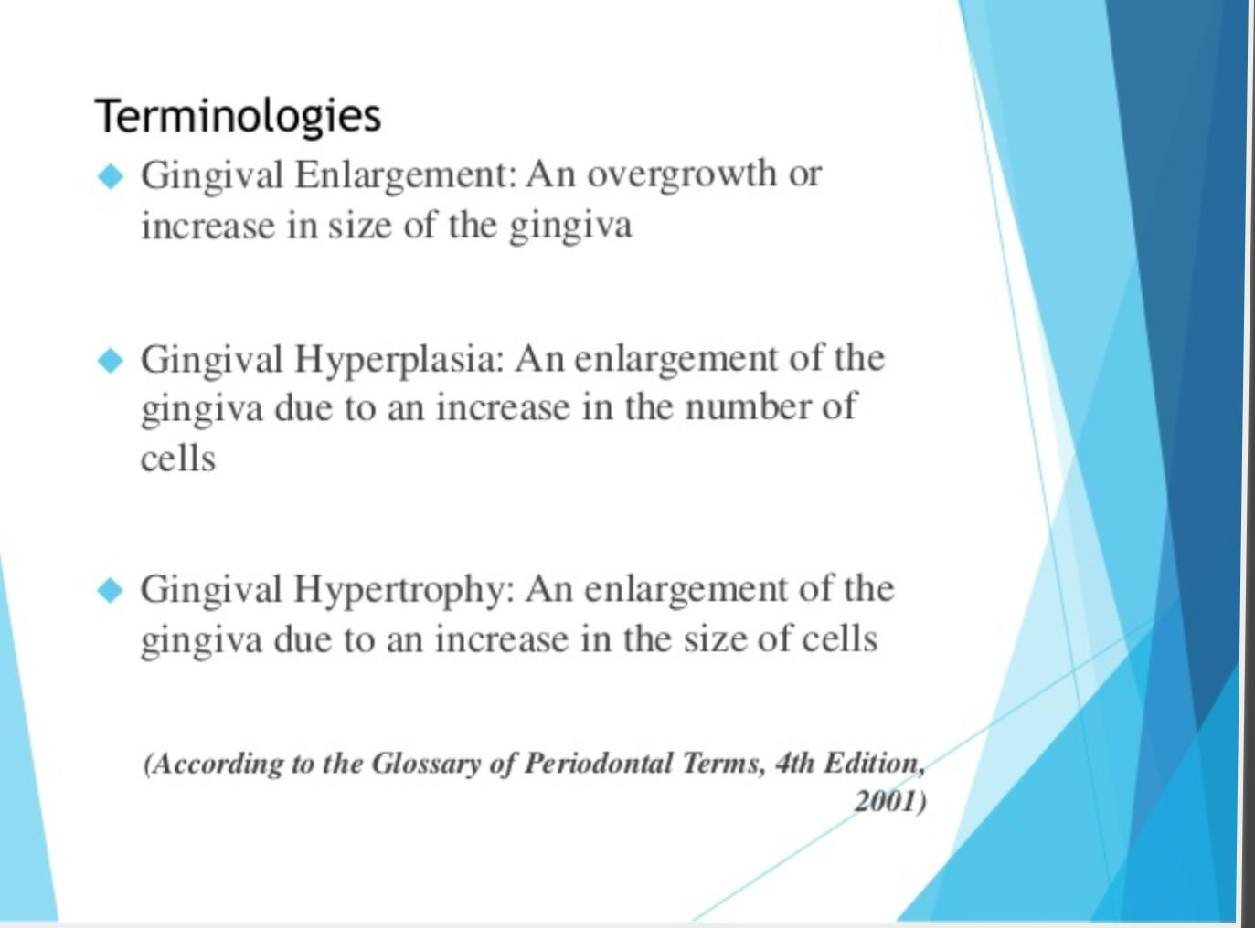

Slide 3
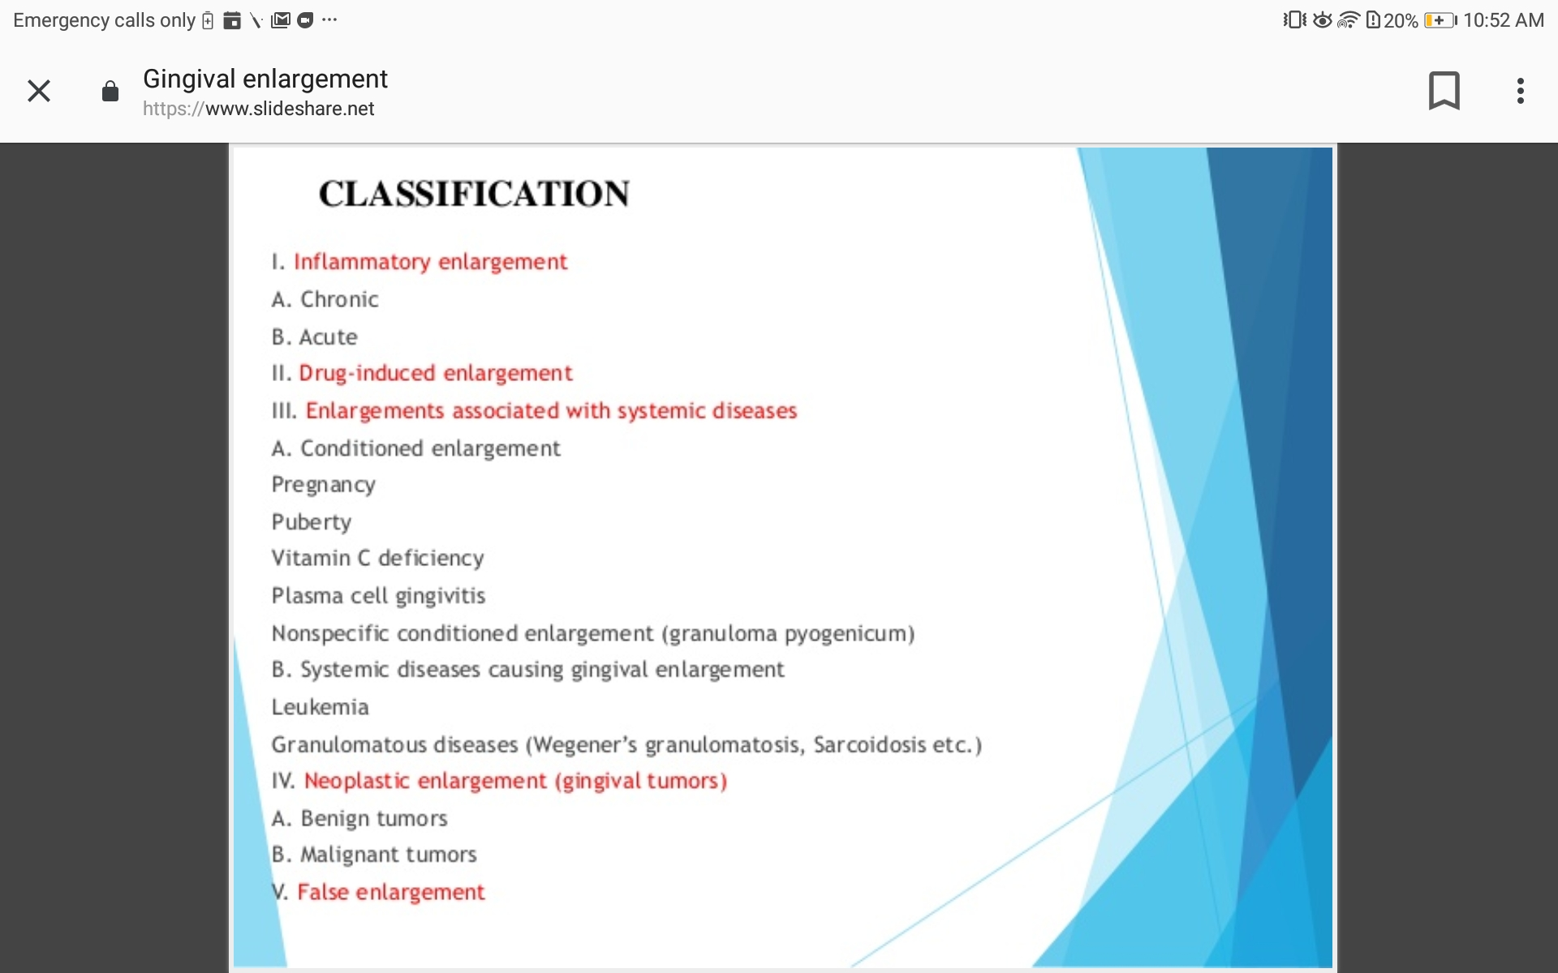

Slide 4
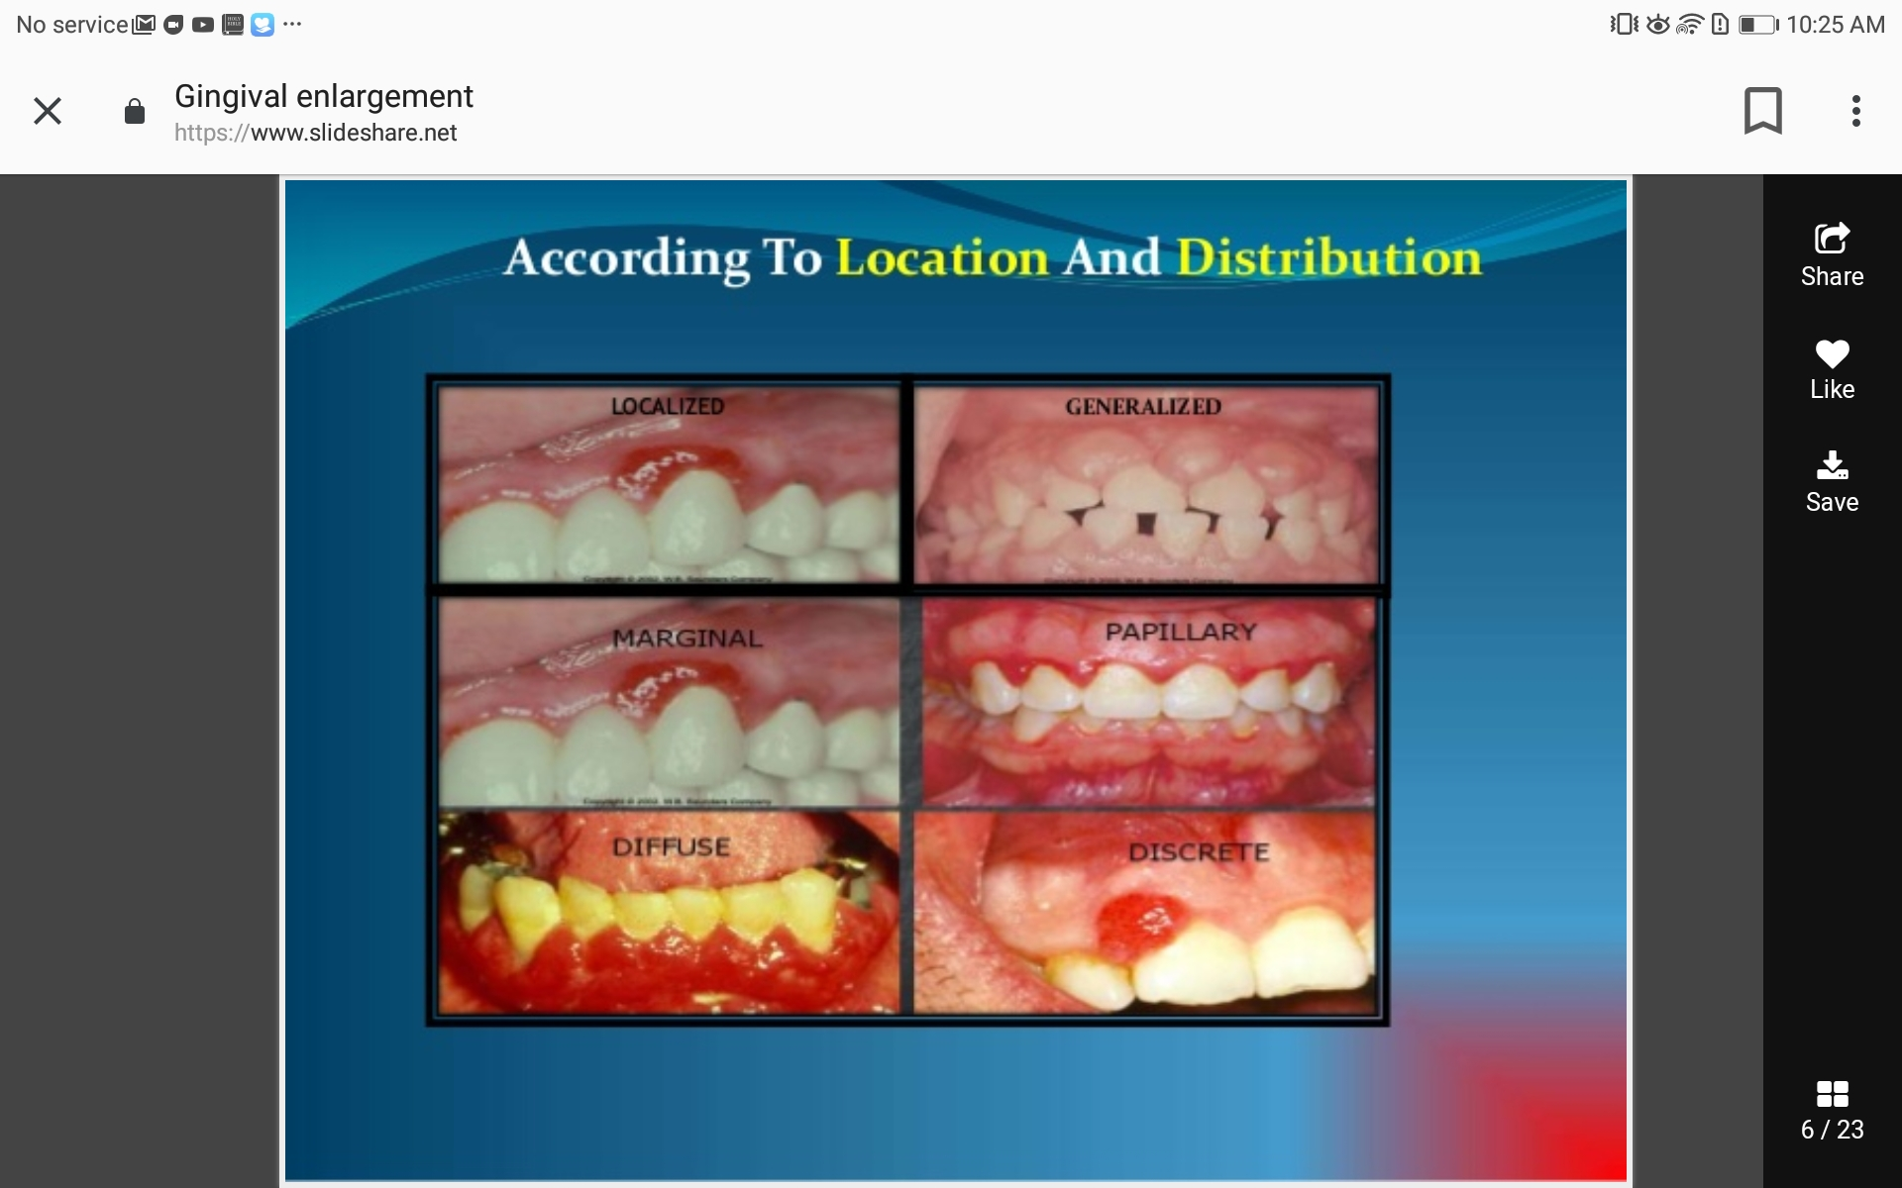

Slide 5
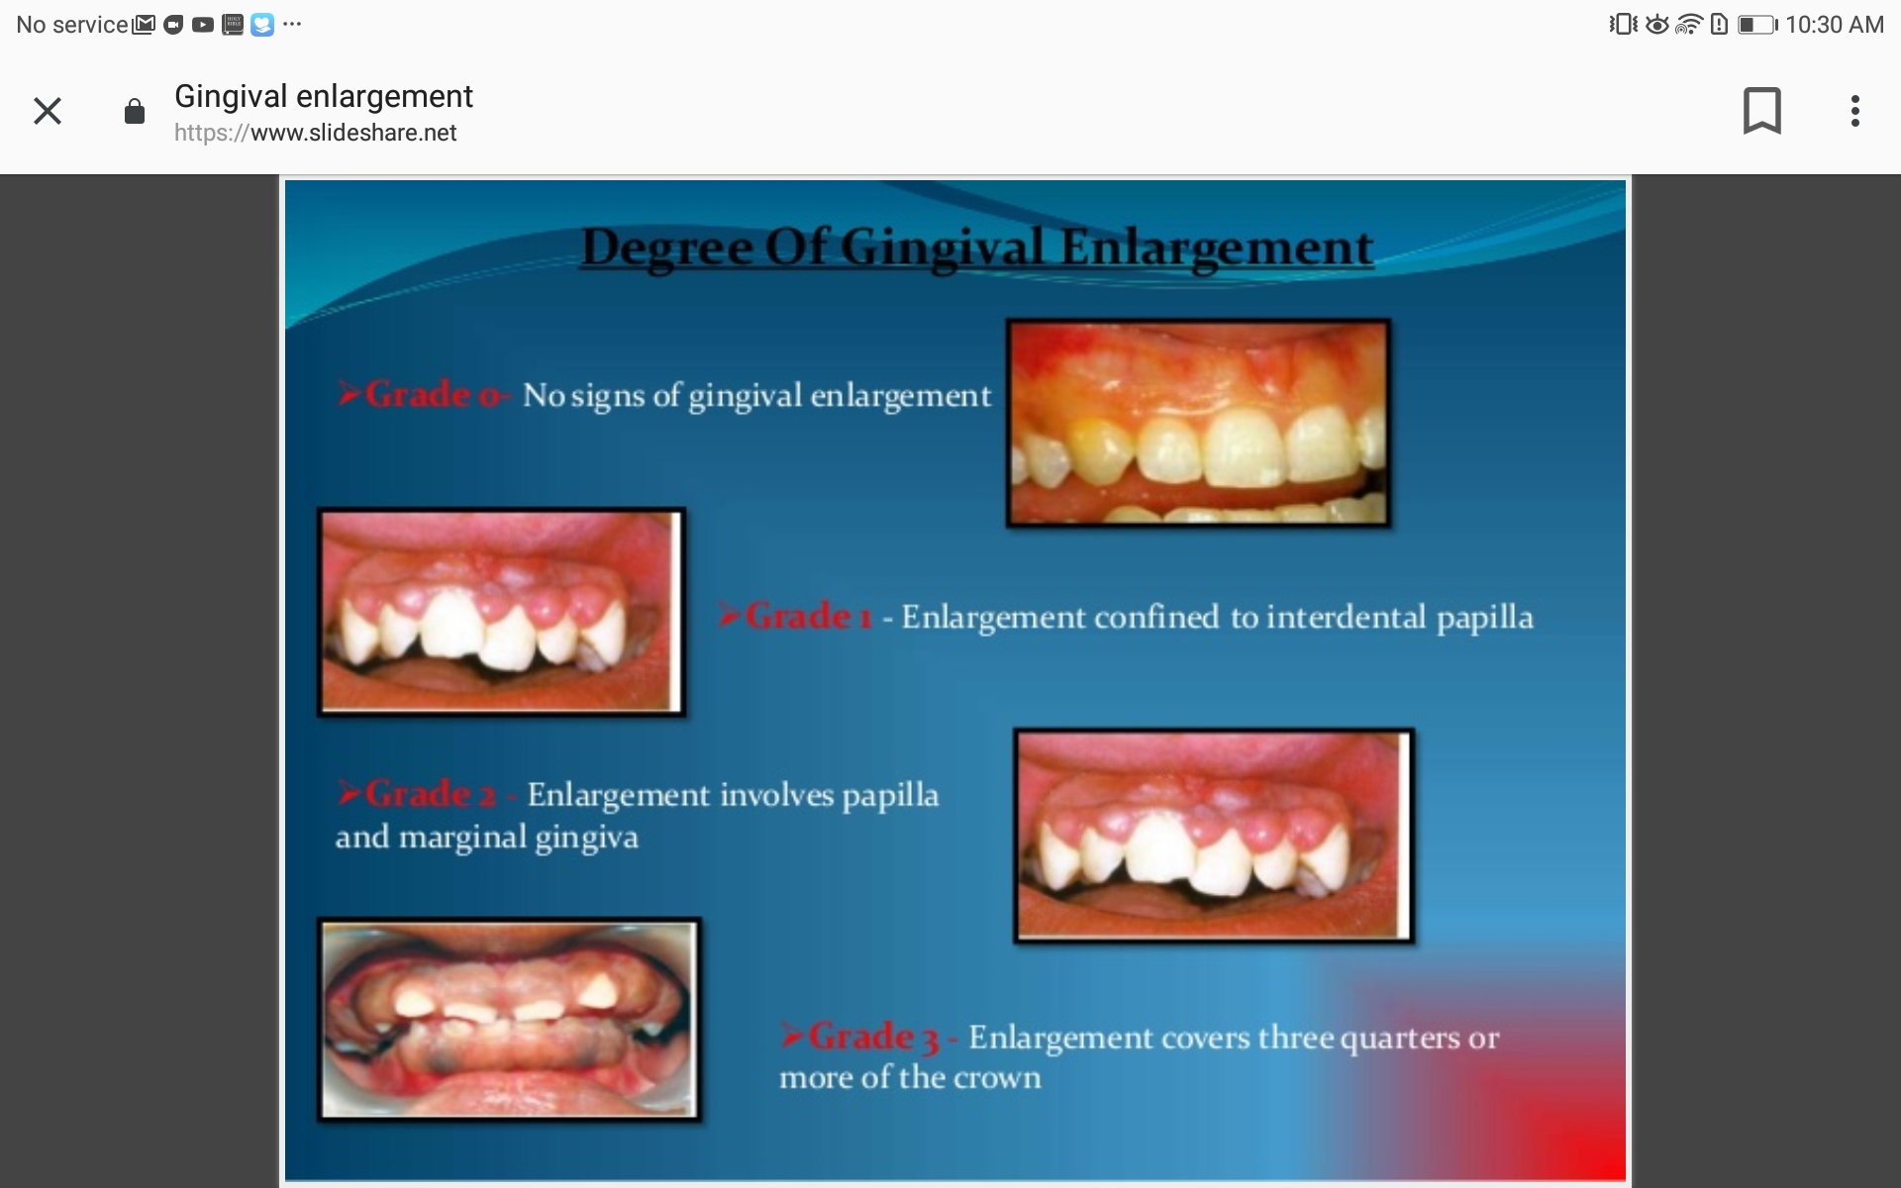
The degree of gingival enlargement can be scored as follows:
• Grade 0: no signs of gingival enlargement
• Grade I: enlargement confined to interdental papilla
• Grade II: enlargement involves papilla and marginal gingiva
• Grade III: enlargement covers three-fourths or more of the crown

Slide 6
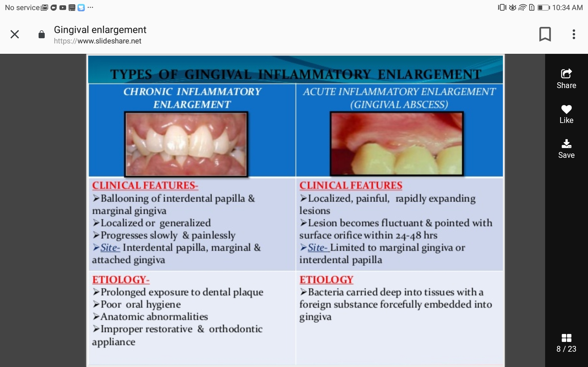
Chronic inflammatory enlargement

Slide 7
Drug induced gingival enlargement

Slide 8
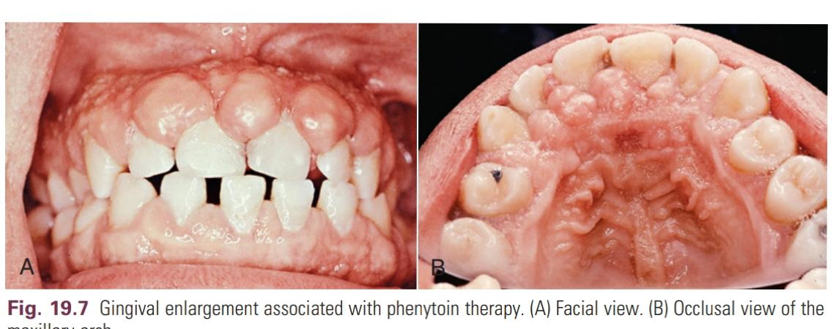
anticonvulsants (phenytoin), calcium channel blockers(nifedipine), and immunosuppressants(cyclosporine)
Results in impaired oral hygiene, biofilm accumulation, and gingival inflammation
lesions usually develop fast and become chronic over time
The first signs of overgrowth can be observed as early as 3 months of drug use as a localized nodular enlargement of the interdental papilla.
the lesions expand and in some cases cover the crowns of the teeth - complete coverage of dental surfaces

Slide 9
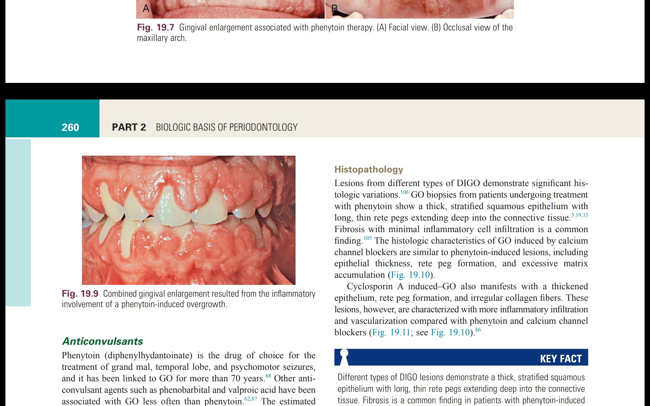
degree of fibrosis and inflammation depend on the
- dose, duration, and type of drug
Oral hygiene;
individual susceptibility, including genetic factors; and
environmental influences

Slide 10
Anticonvulsants
Phenytoin (diphenylhydantoinate) is the drug of choice for the treatmentt of grand mal, temporal lobe, and psychomotor seizures, and it has been linked to GO for more than 70 years.
Other anti convulsant agents – phenobarbital and valproic acid less associated with GO
The estimated prevalence of phenytoin-induced GO is about 50%.22
Clinical onset occurs as early as 1 month, and increasing severity is seen in 12 to 18 months.
frequently occur on the anterior buccal maxilla and mandible, and the entire dentition can be covered in severe cases.
characterized by enlargement of interdental papillae and increased thickening of the marginal tissues, causing aesthetic and functional problems, such as malpositioning of teeth, difficulty in speech, and impaired oral hygiene.

Slide 11
Calcium Channel Blockers
Calcium channel blockers are a group of drugs commonly used to treat hypertension, angina pectoris, coronary artery spasm, and cardiac arrhythmia.
Benzothiazepine derivatives (e.g., diltiazem), phenyl-alkylamine derivatives (e.g., verapamil), and dyhydropyridines (e.g., amlopidine, felodipine, isradipine, nicardipine, nifedipine, nitrendipine, oxodipine, nimodipine, nisoldipine)
the prevalence of nifedipine-induced GO is highly variable,
Clinically, interdental papillae are affected, and overgrowth is limited to attached and marginal gingiva,which usually is observed on the anterior segments.
Nifedipine-induced GO can coexist with periodontitis and attachment loss that iss different from other forms of DIGO.

Slide 12
Immunosuppressants
Cyclosporin A has been the immunosuppressant of choice for preventing rejection of solid organ and bone marrow transplants and for treatment of autoimmune conditions
The prevalence of cyclosporin A–induced GO has been reported to be about 30% but it can be much higher, especially for pediatric populations.58
Clinically, the lesions are more inflamed and bleed more than other forms of DIGO, and they commonly are limited to buccal surfaces.
Severity of the lesions can be similar to those of phenytoin and nifedipine.
They affect the entire dentition and interfere with occlusion, mastication, and speech

Slide 13
Histopathology
Different types of DIGO lesions demonstrate a thick, stratified squamous epithelium with long, thin rete pegs extending deep into the connective tissue.
Fibrosis is a common finding in patients with phenytoin-induced GO.
Histologic characteristics of GO induced by calcium channel blockers similar to those of phenytoin-induced lesions- epithelial thickness, rete peg formation, and excessive matrix accumulation.
Cyclosporin A–induced GO lesions have more inflammatory infiltration and increased vascularization

Slide 14
Pathogenesis of Drug-Induced Gingival Overgrowth
The pathogenesis of DIGO is complex.
main mechanism - through defective function of gingival fibroblasts (decreasing collagenase activity and increasing the production of matrix proteins)
inflammatory regulation of tissue turnover is a major factor in DIGO pathogenesis
- increased levels of interleukin-6 (IL-6), IL-1β, platelet-derived growth factor subunit B (PDGFB), fibroblast growth factor 2 (FGF2), transforming growth factor-β (TGF-β), and connective tissue growth factor (CTGF)[source-macrophage]
- some degree of epithelial-mesenchymal transition induced ( epithelial cells in the gingiva acquire fibroblast function, and the process is regulated by CTGF)

Slide 15
treatment
DIGO cannot be prevented
can be ameliorated by elimination of local factors, plaque control, and regular periodontal maintenance
most effective treatment for drug-induced gingival overgrowth is withdrawal or substitution of the medication
Nonsurgical treatment results in elimination of the inflammatory component of DIGO.
Surgical elimination of DIGO lesions involves gingivectomy and gingivoplasty.
Chronic periodontitis alongwith DIGO- true pocket>5mm- internal bevel gingivectomy /undisplaced flap
The recurrence rate is high.
Maintenance should include oral hygiene instructions, periodontal prophylaxis, and removal of calculus as needed.

Slide 16
Gingival Overgrowth Associated With Systemic Conditions

Slide 17
Pregnancy-Associated Gingival Overgrowth

Slide 18
Clinical Manifestations
it manifests as a single mass or multiple tumor-like masses at the gingival margin
Marginal gingival enlargement during pregnancy results from the aggravation of previous inflammation
Enlargement is usually generalized
tends to be more prominent interproximally than on the facial and lingual surfaces.
enlarged gingiva is bright red or magenta, soft, and friable, and it has a smooth, shiny surface
Bleeding occurs spontaneously or on slight provocation.

Slide 19
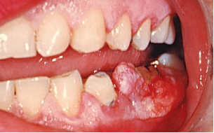
Pregnancy tumor(single mass)
- not neoplasms
- an inflammatory response to microbial plaque modified by the patient’s condition
- usually appears after the third month of pregnancy,
- lesion appears as a discrete, mushroom-like, flattened spherical mass that protrudes from the gingival margin or, more often, from the interproximal space, and it is attached by a sessile or pedunculated base
tends to expand laterally, and pressure from the tongue and the cheek perpetuates its flattened appearance
It is dusky red or magenta; it has a smooth, glistening surface that often exhibits numerous deep red, pinpoint markings.

Slide 20
usually does not invade the underlying bone
The mass is usually firm, but it may have various degrees of softness and friability.
is usually painless unless its size and shape foster the accumulation of debris under its margin or interfere with occlusion, in which case painful ulceration may occur.
microscopic findings are characteristic of gingival enlargement during pregnancy, they are not pathognomonic

Slide 21
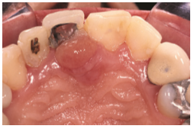
Pyogenic granuloma is similar in clinical and microscopic appearance to the gingival enlargement seen during pregnancy
[manifests as a tumor-like gingival enlargement that is considered to be an exaggerated response to minor trauma.
The exact nature of the systemic conditioning factor has not been identified.
The differential diagnosis is based on the patient’s history]

Slide 22
Etiology
Hormonal changes have always been linked to pathology in periodontal tissues. For example, progesterone and estrogen levels increase 10 to 30 times by the end of the third trimester compared with the menstrual cycle
Prevotella intermedia, Prevotella melaninogenica, and Porphyromonas gingivalis

Slide 23
histopathology
Gingival enlargement in pregnancy is called angiogranuloma,
Marginal and tumor-like enlargements consist of a central mass of connective tissue, with numerous diffusely arranged, newly formed, and engorged capillaries lined by cuboid endothelial cells and of a moderately fibrous stroma with various degrees of edema and chronic inflammatory infiltrate.
The stratified squamous epithelium is thickened, with prominent rete pegs and some degree of intracellular and extracellular edema, prominent intercellular bridges, and leukocytic infiltration

Slide 24
Treatment
can be prevented by good oral hygiene
Oral care in pregnant women should be meticulous, and patients should be treated by removal of plaque and calculus.
Severe cases may require removal during the second trimester; however, removal of the GO lesions without establishment of an optimal oral hygiene regimen ensures recurrence of gingival enlargement.
spontaneous reduction in the size of gingival enlargement typically follows the termination of pregnancy,
complete elimination of the residual inflammatory lesion and GO requires removal of all plaque deposits, elimination of factors that favor its accumulation, and in some fibrotic cases, surgical intervention.

Slide 25
Treatment of pyogenic granuloma consists of the removal of the lesions and the elimination of irritating local factors.
The recurrence rate of pyogenic granuloma is about 15%

Slide 26
Puberty-Associated Gingival Overgrowth

Slide 27
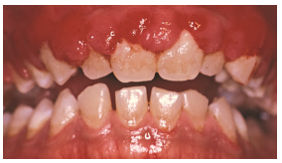
Clinical Manifestations
Enlargement of the gingiva is sometimes seen during puberty.
they occur in male and female adolescents
there is a strong association with plaque accumulation.
lesions are usually marginal and interdental, and they are characterized by prominent bulbous interproximal papillae
only the facial gingivae are enlarged, and the lingual surfaces are relatively unaltered (mechanical action of the tongue and the excursion of food prevent a heavy accumulation of local irritants on the lingual surface)

Slide 28
Etiology
Hormonal changes with or without presence of excessive plaque
Capnocytophaga species , Prevotella intermedia and Prevotella nigrescens

Slide 29
Histopathology
The microscopic appearance of gingival enlargement during puberty is one of chronic inflammation with prominent edema

Slide 30
Treatment
After puberty, enlargement undergoes spontaneous reduction, but it does not disappear completely until the plaque and calculus are removed

Slide 31
Nutrition-Associated Gingival Overgrowth scurvy

Slide 32
Clinical Manifestations
Gingival enlargement is marginal
The gingiva is bluish red, soft, and friable, and it has a smooth, shiny surface.
Hemorrhage that occurs spontaneously or on slight provocation and surface necrosis with pseudomembrane formations are common features.

Slide 33
Etiology
Acute vitamin C deficiency - cause hemorrhage, collagen degeneration, and edema of the gingival connective tissue
These changes modify the response of the gingiva to plaque to the extent that the normal defensive delimiting reaction is inhibited and the extent of the inflammation is exaggerated, thereby resulting in the massive gingival enlargement seen in patients with scurvy

Slide 34
Histopathology
the gingiva has a chronic inflammatory cellular infiltration with a superficial acute response.
There are scattered areas of hemorrhage with engorged capillaries.
Marked diffuse edema, collagen degeneration, and a scarcity of collagen fibrils and fibroblasts are striking findings

Slide 35
Treatment
Nutrition-associated GO lesions are rare.
Changes in nutrition accompanied by nonsurgical treatment and good oral hygiene usually result in complete resolution of the pathology.
In rare cases, surgical removal may be indicated

Slide 36
Gingival Overgrowth Associated With Systemic Diseases

Slide 37
Leukemia-Associated Gingival Overgrowth

Slide 38
Clinical Manifestations
GO can be diffuse or marginal and localized or generalized
It can appear as a diffuse enlargement of the gingival mucosa, an oversized extension of the marginal gingiva or a discrete tumor-like interproximal mass
the gingiva is bluish red, and it has a shiny surface
The consistency is moderately firm, but there is a tendency toward friability and hemorrhage that occur spontaneously or with slight irritation.
Acute painful necrotizing ulcerative inflammatory involvement can occur in the crevice formed at the junction of the enlarged gingiva and the contiguous tooth surfaces.
Patients with leukemia may also have a simple chronic inflammation without the involvement of leukemic cells, and they can have the same clinical and microscopic features seen in patients without the systemic disease.

Slide 39
Most cases have features of simple chronic inflammation and leukemic infiltrate.
True leukemic enlargement often occurs with acute leukemia, but it may also be seen with subacute leukemia. It seldom occurs with chronic leukemia.

Slide 40
Histopathology
show various degrees of chronic inflammation
Mature leukocytes are seen along with areas of connective tissue that are infiltrated with a dense mass of immature and proliferating leukocytes, the specific nature of which varies with the type of leukemia.
Engorged capillaries, edematous and degenerated connective tissue, and epithelium with various degrees of leukocytic infiltration and edema are found.
Isolated surface areas of acute necrotizing inflammation with a pseudomembranous meshwork of fibrin, necrotic epithelial cells, polymorphonuclear leukocytes, and bacteria are often seen.

Slide 41
Wegener Granulomatosis

Slide 42
Clinical Manifestations
rare disease that is characterized by acute granulomatous necrotizing lesions of the respiratory tract, including nasal and oral defects.
Renal lesions develop, and acute necrotizing vasculitis affects the blood vessels.
The initial manifestations involve orofacial region- oral mucosal ulceration, gingival enlargement, abnormal tooth mobility, exfoliation of teeth, and a delayed healing response.
The granulomatous papillary enlargement is reddish purple and bleeds easily on stimulation

Slide 43
Etiology
The cause is unknown
the condition is considered an immunologically mediated tissue injury.
At one time the usual outcome for patients with this condition was death from kidney failure within a few months, but more recently the use of immunosuppressive drugs has produced prolonged remissions in more than 90% of patients.

Slide 44
Histopathology
Chronic inflammation involves scattered giant cells, foci of acute inflammation, and microabscesses covered by a thin, acanthotic epithelium.

Slide 45
Sarcoidosis

Slide 46
Clinical Manifestations
is a granulomatous disease of unknown etiology.
It starts in individuals during their 20s or 30s,
it predominantly affects blacks, and it can involve almost any organ, including the gingiva, in which a red, smooth, painless enlargement may appear

Slide 47
Histopathology
Sarcoid granulomas consist of discrete epithelioid cells and multinucleated, foreign body–type giant cells with peripheral mononuclear cells.

Slide 48
Gingival Fibromatosis

Slide 49
Clinical Manifestations
Gingival fibromatosis can be hereditary or idiopathic.
These lesions are rare and occur in highly fibrotic forms of GO
Hereditary gingival fibromatosis is the most common form
ldiopathic gingival enlargement is a rare condition of undetermined cause.

Slide 50
Site-: The enlargement affects the attached gingiva, the gingival margin, and the interdental papillae.
The facial and lingual surfaces of the mandible and maxilla usually are affected,
but the involvement may be limited to either jaw.
Consistency - The enlarged gingiva is pink, firm, and almost leathery in consistency
it has a characteristic minutely pebbled surface
In severe cases, the teeth are almost completely covered, and the enlargement projects into the oral vestibule.
The jaws appear distorted because of the bulbous enlarge-ment of the gingiva.
Secondary inflammatory changes are common at the gingival margin.

Slide 51
Etiology
The genetic basis of hereditary gingival fibromatosis is well established, with different populations having different genetic loci and specific genes
In some families, gingival enlargement is linked to impairment of physical development.
Other syndromes can coexist with gingival fibromatosis.
Idiopathic forms of gingival fibromatosis have not been linked to any specific genes.

Slide 52
Enlargement usually begins with the eruption of the primary or secondary dentition, and it may regress after extraction
the teeth or the plaque attached to them may be initiating factors
presence of bacterial plaque is a complicating factor.
Gingival enlargement has been described in tuberous sclerosis, which is an inherited condition
characterized by the triad of epilepsy, mental deficiency, and cutaneous
angiofibromas

Slide 53
Histopathology
the lesions are highly fibrotic, with a bulbous increase in connective tissue that is relatively avascular and consists of densely arranged collagen bundles and numerous fibroblasts.
The surface epithelium is thickened and acanthotic, with elongated rete pegs
collagen bundle formation, dominance, and orientation are distinctive in areas where cellular structures are reduced

Slide 54
Treatment
Gingivectomy
Gingivoplasty
Recurrence rate is high
Might need orthodontic correction

Slide 55
False enlargement

Slide 56
Underlying osseous lesions
tori and exostoses
Paget disease,
fibrous dysplasia,
Cherubism
Central giant cell granuloma,
ameloblastoma,
osteoma, and
osteosarcoma.

Slide 57
Underlying dental tissues
Developmental enlargement- associated with eruption of primary dentition

Slide 58
Neoplastic enlargement (gingival tumors)

Slide 59
Benign tumor of gingiva

Slide 60
Epulis
a generic term that is used to clinically designate all discrete tumors and tumor-like masses of the gingiva.
It serves to locate the tumor but does not describe it.
Most lesions referred to by this term are inflammatory rather than neoplastic.

Slide 61
Fibroma
arise from the gingival connective tissue or from the periodontal ligament
slow-growing, spherical tumors that tend to be firm and nodular but that may be soft and vascular
are usually pedunculated
Hard fibromas of the gingiva are rare; most of the lesions that are diagnosed clinically as fibromas are inflammatory enlargements.
Histopathology
demonstrates bundles of well-formed collagen fibers with scattered fibrocytes and various degrees of vascularity
giant cell fibroma contains multinucleated fibroblasts
mineralized tissue (i.e., bone, cementum-like material, and dystrophic calcifications)- peripheral ossifying fibroma

Slide 62
Papilloma
papillomas are benign proliferations of surface epithelium
associated with human papillo-mavirus (HPV) infection.
Gingival papillomas appear as solitary wartlike or cauliflower-like protuberances
small and discrete, or they can be broad, hard elevations with minutel irregularr surfaces.
The lesions consist of finger-like projections of stratified squamous epithelium that are often hyperkeratotic, with central cores of fibrovascular connective tissue.

Slide 63
Peripheral giant cell granulomas
arise interdentally or from the gingival margiN
occur most frequently on the labial surface, and they can be sessile or pedunculated
vary in appearance from smooth, regularly outlined masses to irregularly shaped, multilobulated protuberances with surface indentations
Ulceration of the margin is occasionally seen.
The lesions are painless, vary in size, and can cover several teeth.
They can be firm or spongy, and their color varies from pink to deep red or purplish blue.
Clinically, cannot be easily differentiated from other forms of gingival enlargement.

Slide 64
In some Cases is locally invasive and causes destruction of the underlying bone
Complete removal leads to uneventful recovery.
The lesion has numerous foci of multinuclear giant cells and hemosiderin particles in a connective tissue stroma (see Fig. 19.23B).
Areas of chronic inflammation are scattered throughout the lesion, with acute involvement occurring at the surface
Overlying epithelium is usually hyperplastic, with ulceration at the base
Bone destruction occasionally occurs within the lesion

Slide 65
Gingival cyst
Gingival cysts of microscopic proportions are common, but they seldom reach a clinically significant size.
When they do, they appear as localized enlargements that may involve the marginal and attached gingiva.
The cysts occur in the mandibular canine and premolar areas, most often on the lingual surface.
They are painless, but with expansion they can cause erosion of the surface of the alveolar bone.
The gingival cyst should be differentiated from the lateral periodontal cyst, which arises within the alveolar bone adjacent to the root and which is developmental in origin.
Gingival cysts develop from odontogenic epithelium or from surface or sulcular epithelium traumatically implanted in the area.
Removal is followed by uneventful recovery

Slide 66
A gingival cyst cavity is lined by a thin, flattened epithelium with or without localized areas of thickening.
Less frequently: unkeratinized stratified squamous epithelium, keratinized stratified squamous epithelium, and parakeratinized epithelium with palisading basal cells.

Slide 67
Malignant tumors of gingiva

Slide 68
Squamous cell carcinoma
is the most common malignant tumor of the gingiva.
It may be exophytic, manifesting as an irregular outgrowth, or ulcerative, appearing as a flat, erosive lesion.
It is often symptom free, going unnoticed until complicated by inflammatory changes that can mask the neoplasm but cause pain; it sometimes becomes evident after tooth extraction.
These masses are locally invasive, and they involve the underlying bone and periodontal
ligament of adjoining teeth and the adjacent mucosa
Metastasis is usually confined to the region above the clavicle; however, involvement that is more extensive can include the lung, liver, or bone.

Slide 69
Malignant melanoma is a rare oral tumor that tends to occur in the hard palate and maxillary gingiva of older persons
It is usually darkly pigmented, and it is often preceded by localized pigmentation.
It can be flat or nodular, and it is characterized by rapid growth and early metastasis.
It arises from melanoblasts in the gingiva, cheek, or palate.
Infiltration into the underlying bone and metastasis to cervical and axillary lymph nodes are common.

